Slide 1
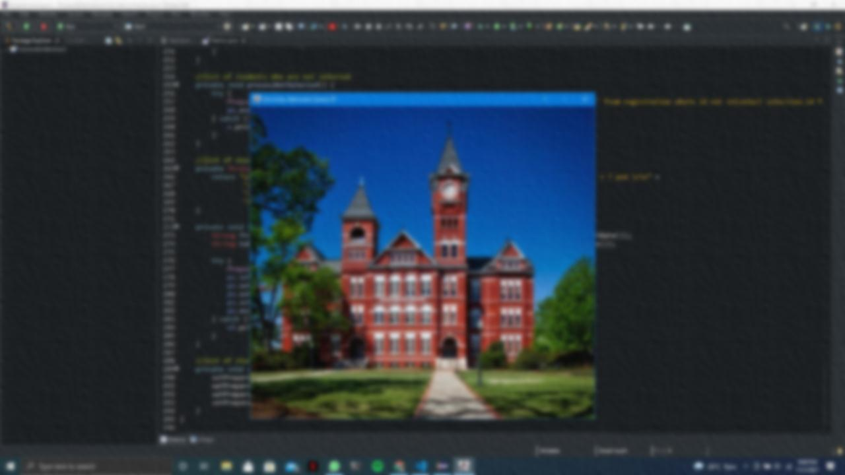
University Admission System Presentation

Slide 2
Group Members
Vistaar
Vijai
Karthika

Slide 3
Tools and Technologies
Java 2 Enterprise Edition
SwingGUI
Windows Builder tool for creating SwingGUI project
EclipseIDE
MySQL for Database Connectivity

Slide 4
Introduction To Java
Java is a popular programming language, created in 1995.
A general purpose object-oriented language
Write Once Run Anywhere(WORA)
Designed for easy Web/Internet Application
Widespread acceptance

Slide 5
Characteristics of Java
Simple
Object-oriented
Distributed
Interpreted
Robust
Portable
Secure
Multithreading
Secure

Slide 6
Java Edition
J2SE(Java 2 Standard Edition): To develop client-side standalone applications or applets
J2ME(Java 2 Micro Edition): To develop applications for mobile devices such as cell phones.
J2EE(Java 2 Enterprise Edition): To develop server-side applications such as Java Servlets and Java Server Page

Slide 7
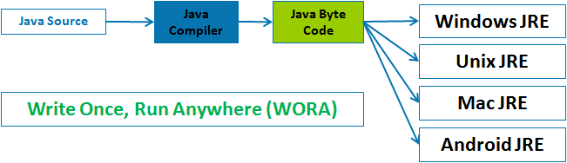
WORA(Write Once Run AnyWhere

Slide 8
WORA(Write Once Run AnyWhere
We create a java source code with extension .java
After that we compile our source code
The compiler converts our source code(.java) into byte code(.class)
And this byte code makes java platform independent

Slide 9
Introduction To SwingGUI
It is an Application Programming Interface(API) for providing Graphical User Interface(GUI)
Swing is built on the foundation of AWT
Swing suppors pluggable Look and Feel
Swing Components are lightweight

Slide 10
Introduction to MySQL
A Relational Database Management System
MySQL Database Server is very fast, reliable, and easy to use
MySQL software is open source software

Slide 11
Welcome To Our University

Slide 12
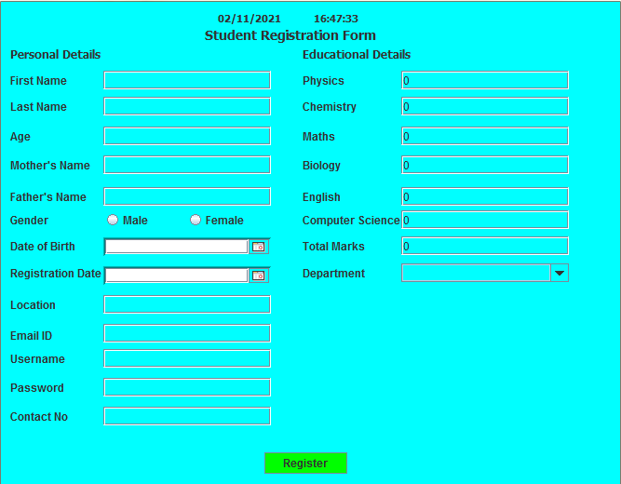
Student Registration Page

Slide 13
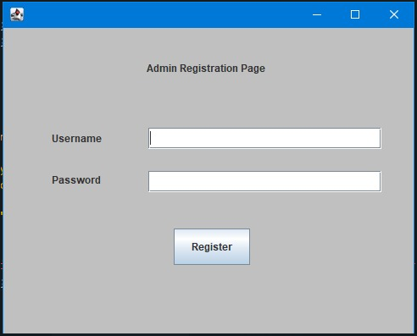
Admin Registration Page

Slide 14
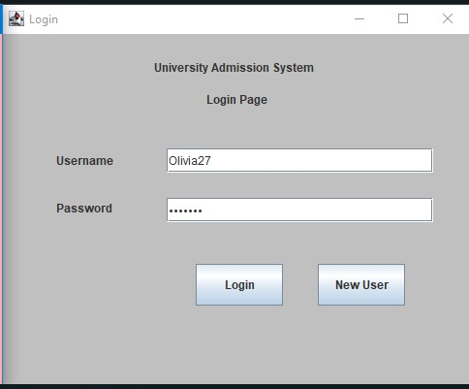
Login Page

Slide 15
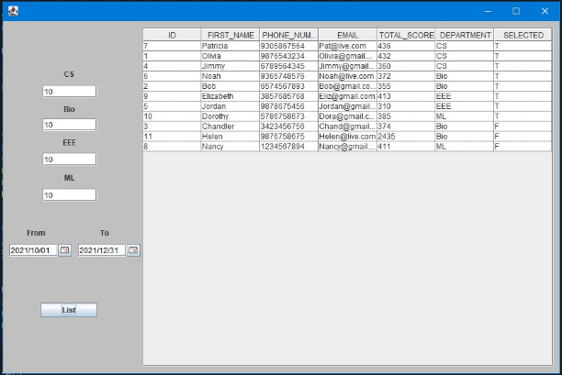
Admin Application Window

Slide 16
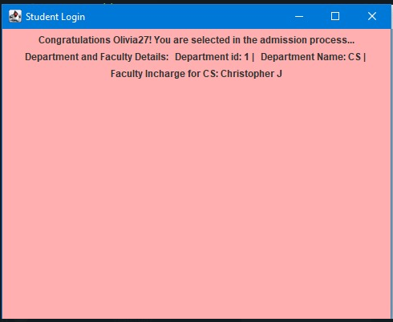
Student Application Window

Slide 17
Flow Diagram
1
If(user.equals(Student))
2
Admin Registration Page
User
3
Student Registration Form
4
5
Login Page
6
Student Application Window
7
If new user
If Student
9
Admin Application Window
8
10

Slide 18
Flow Diagram
User:We will check if user is a student or admin(1)
If user is student then it will be directed to Student Registration Form(3)
Else it will be directed to Admin Registration Form(2)
Now both Student and Admin will Login and will be directed to Login page(4 & 5 respectivley)

Slide 19
Cont……
In Login window we have two choice login or new user
If it is a new user (6) then we will redirected student registration form(7)
Else we will check the enter login credentials(8) is of Student or Admin then accordingly redirected to Student Application Window(9) or Admin Application Window(10)

Slide 20


